Slide 1
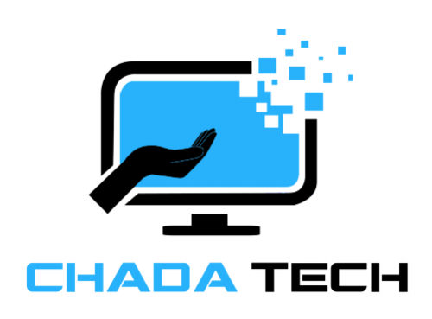
AGILE DEVELOPMENT

Slide 2
Understanding the Agile Roles
Product Owner
Maximizes value of the product and work of the Development Team.
Scrum Master
Guides Agile principals
Is the servant-leader to the Product Owner.
Facilitates Scrum events.
Enforce scrum ceremonies and processes
Development Team
Consisting of Developers and Testers
Self-organized
Inter-disciplinary

Slide 3
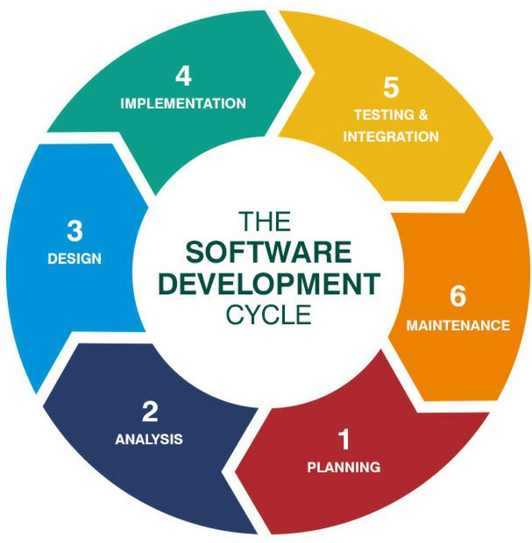
SLDC: Software development lifecycle
Planning and Analysis
Collaborate with different stakeholders.
Organize the Requirements.
Define technologies, limitations, time frames, and budget.
Design
Create a detailed process for functionality.
Functionality is then broken up into smaller increments and assigned.
Implementation
Occurs In conjunction with Development.
Testing/ Integration
Testing commences
Process for identifying and mitigating reported defects and issue tracking.
Maintenance
Product in the production environment and released to the market.
Developers must be ready to implement NEW features and bug fixes as they come up.
Notes:
Planning and Analysis -The essential building component of the software development lifecycle is analysis. This is when leadership works with various stakeholders to gather project needs.
Design - The functionality is specified in depth at this phase. The technologies employed, project resources, constraints, time limits, and budgets are all described.
Implementation - Development begins in this phase. The programming language employed is determined by the project. Because each functionality is broken down into smaller increments to enable value-based code development, this is the longest step of the SDLC.
Testing and Integration - Testing is complete, and the product is ready for market release. Before going to market, UAT (User Acceptance Testing) may be undertaken in a confined setting.
Maintenance – At this point, the product has been released to the market. Developers must be prepared to answer any new features, or problem fixes that users request or encounter in production.

Slide 4




Agile vs. waterfall Comparison
AGILE
WATERFALL
Do not need to identify and define ALL requirements
All requirements need to be defined.
Functionalities are evolutionary throughout the process
Contract Negotiations
More freedom on timeframe to market
Linear Stages must be performed in order
Projects are normally cheaper and quickly delivered
Ideal for unchanging projects
Notes:
A waterfall technique would have made the SNHU Travel project impossible to finish. Given the level of uncertainty, any adjustments would have harmed the project. Even with agile's high level of uncertainty, any faults identified would necessitate a modification order to the agreement, which can be expensive.

Slide 5
REFERENCES
Charles G. Cobb. (2015). The Project Manager’s Guide
to Mastering Agile : Principles and Practices for an Adaptive Approach. Wiley. Software Development Life Cycle (SDLC). (2021, May 19). Retrieved december 2022, from
linkedin.com: https://www.linkedin.com/pulse/software-development-life-cycle-sdlc-tutorial-richard-harris/

